Slide 1
Sales Insights using SQL and Tableau
By Nitish Namdeo

Slide 2
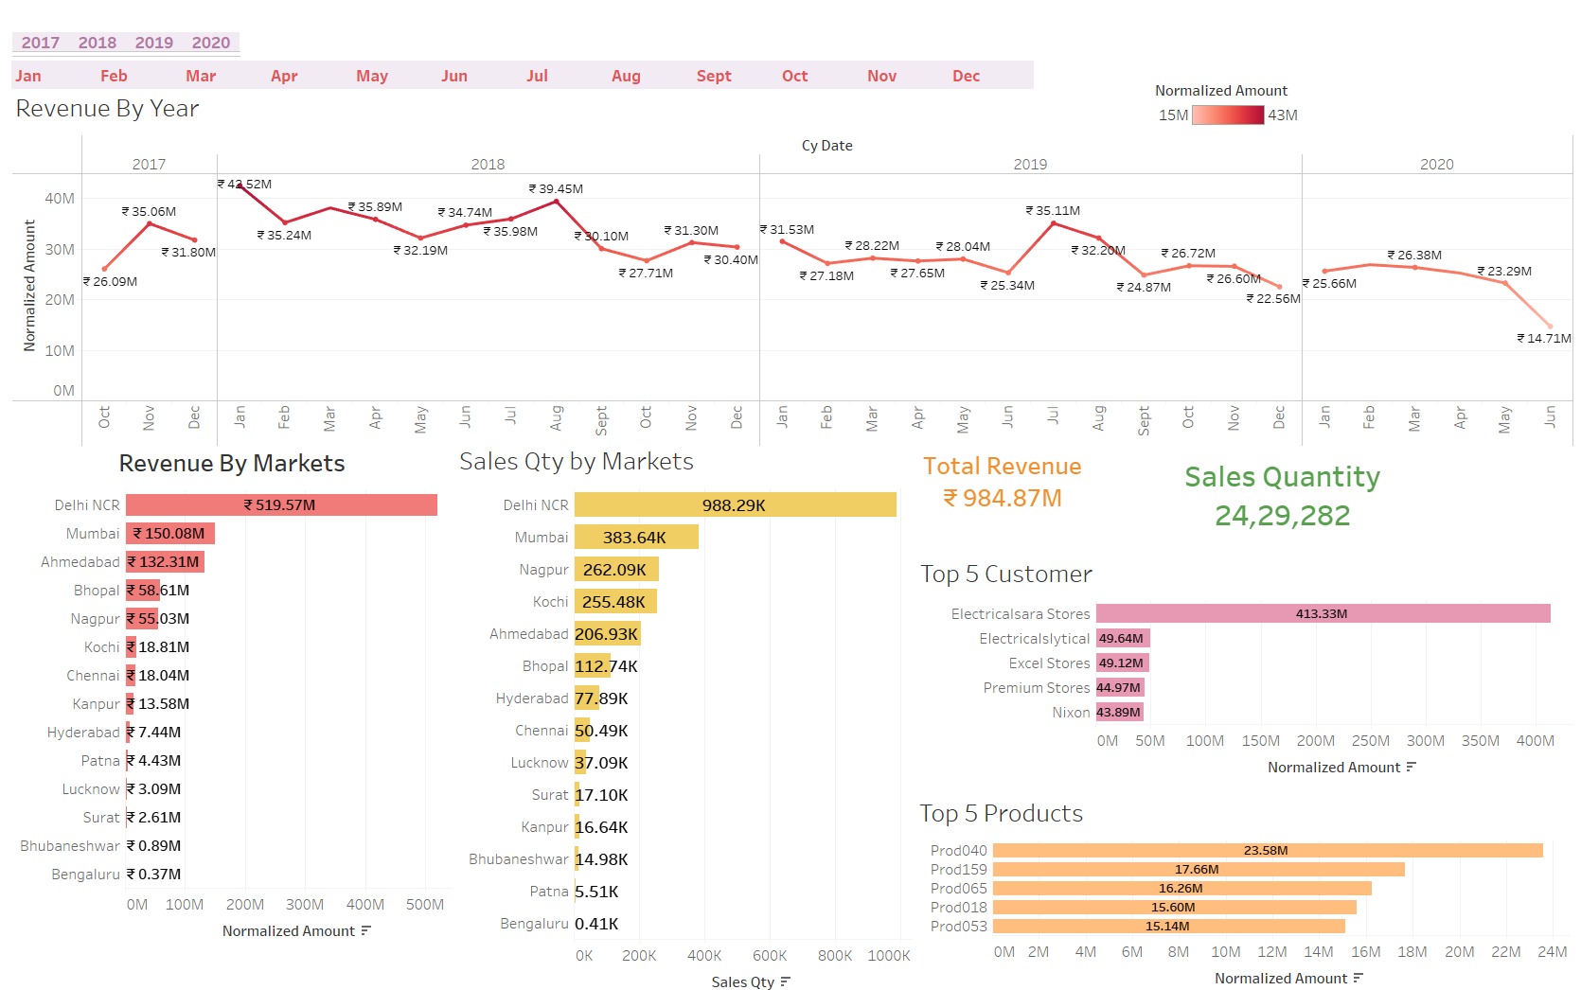
Revenue Analysis

Slide 3
Revenue Analysis
Revenue fluctuates across months and years, with consistent peaks in February and dips in May-June, indicating seasonality in sales.
Delhi NCR is the top-performing market, contributing ₹519.57M to total revenue, while smaller regions like Bhubaneswar and Bengaluru exhibit minimal contributions.
Delhi NCR also leads in sales quantity with 988.29K units, followed by Mumbai (383.64K) and Nagpur (262.09K). This indicates a strong customer base in the NCR region.
The top customer, Electricalsara Stores, contributes ₹413.33M, vastly outperforming other customers, highlighting its importance to overall revenue.
Product Prod040 leads with ₹23.58M in revenue, followed by Prod159, Prod065, Prod018, and Prod053. These products should be prioritized for marketing and inventory planning.
The company has generated a total revenue of ₹984.87M from the sales of 24,29,282 units over the analyzed period.
Focus should be on improving sales in underperforming regions like Bhubaneswar and Bengaluru while leveraging the high-performing products and customers to improve overall profitability. Seasonal strategies should also be implemented to address dips in May-June.

Slide 4
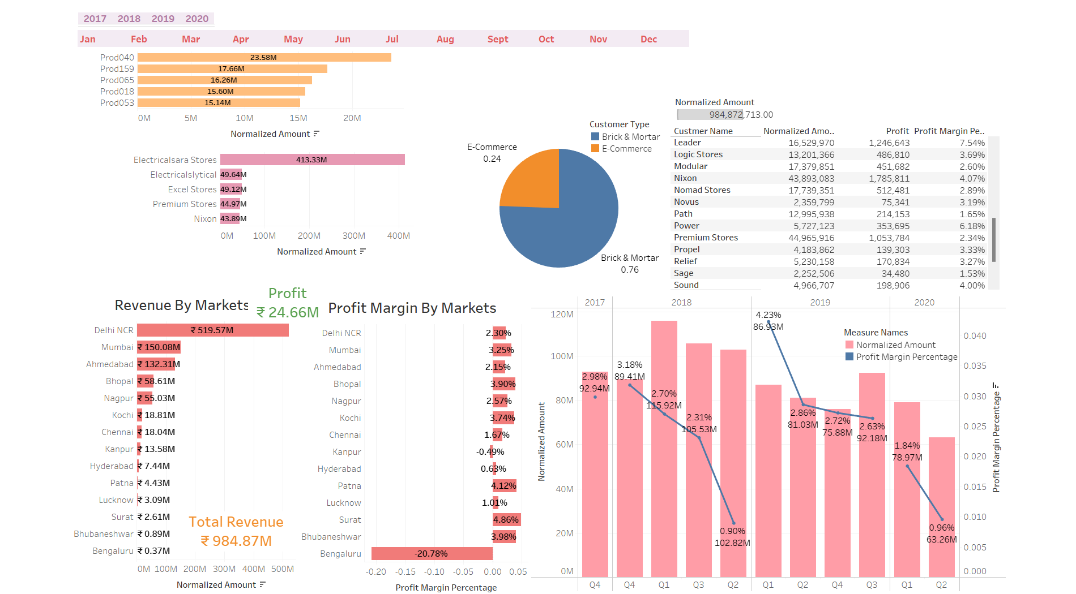
Profit Analysis

Slide 5
Profit Analysis
The total profit generated is ₹24.66M, with Delhi NCR leading in revenue and profit contributions, despite having a moderate profit margin of 2.30%.
Bengaluru shows a negative profit margin of -20.78%, indicating it as a loss-making region that needs immediate attention.
While overall revenue is high (₹984.87M), profit margins vary significantly, with several regions showing low or negative margins despite notable revenue contributions.
76% of revenue comes from Brick-and-Mortar customers, while E-commerce contributes the remaining 24%, suggesting the need to explore growth opportunities in the online segment.
Among the top customers, Electricalsara Stores leads in revenue, but its profit margin is moderate at 2.89%. Other notable customers like Nixon and Premium Stores have relatively better profit margins.
Focus on reducing costs in low-margin or loss-making regions like Bengaluru. Expand E-commerce operations to balance the customer base and improve margins. Implement promotional strategies for high-revenue but low-margin customers like Electricalsara Stores to improve profitability.

